Slide 1
Data Analysis and Interpretation
Dr. Vinit Kumar
Assistant Professor

Slide 2
Why QA ??
In our daily life we encounter with lot of social phenomena.
of quantitative and qualitative nature.
We want to make sense of these observations.

Slide 3
Why QA ??
Knowledge of QA helps us to protect ourselves
from “the propagandists”
one school of thought.
QA helps us in decision making.

Slide 4
What is QA ??
includes methods and procedures for
Summarizing, simplifying, reducing and presenting raw data.
It then
makes predictions, tests hypotheses and infers characteristics of a population from the characteristics of a sample.

Slide 5
What is QA?
includes methods and procedures for
Collection
Organisation and presentation,
Analysis and
Interpretation of raw data.
For making decisions.

Slide 6
Applications
Applied in wide range of academic disciplines:
Natural and Social Sciences
Government
Business
Medicine
Politics
Manufacturing

Slide 7
Applications
Applied in wide range of academic disciplines:
Sports
Engineering
Law
Industry
Psychology
Education

Slide 8
Medicine
Test new drugs
To assess the risk from certain exposures
tools to evaluate tests performed on large groups of animals or people.
Quantify how likely is it that a person with a gene develops a certain illness or characteristic?
Medical research can not be done without QA.

Slide 9
Social and natural sciences
A psychologist might want to observe people with a mental illness,
A biologist may want to see the behaviour of a virus,
A sociologist may like to observe a possible link between criminality and drug abuse.

Slide 10
To evaluate these observations, researchers need to know how to best collect data, how to represent them and interpret in a meaningful way.

Slide 11
Quantitative Analysis
== Statistical Analysis

Slide 12
Presentation and organization of Data
Frequency distributions and graphs
Vinit Kumar
Notes:
The data must be reduced and presented so that the data are more manageable and can be used to assist the decision makers more effectively.

Slide 13
Data
Data
Ungrouped data
Grouped data
7.0 6.3 2.8 7.1 5.6 3.6 5.9 5.4 2.4 5.5 7.1 2.9 4.7 7.1 2.3 3.0 3.9 8.0 4.6 3.6 8.4 4.4 4.1 7.5 3.4 4.8 7.5 4.6 4.7 7.6 6.9 5.9 11.0 6.0 6.4 12.0 11.3 9.6 10.6 9.1 9.7 8.3 8.8 7.6 7.8 6.8 7.5 7.2 8.1 7.7 10.3 7.6 11.2 7.2 11.4 6.8 10.4 6.3 9.5 6.0
Table 1.1: Showing issue rates
Notes:
Raw data, or data that have not been summarized in any way, are sometimes referred to as ungrouped data.
Data that have been organized into a frequency distribution are called grouped data.

Slide 14
Grouped
Class Interval | Frequency
1-<3 | 4
3 - <5 | 12
5 - <7 | 13
7 - <9 | 19
9 - <11 | 7
11 - <13 | 5
Table 1.2: Frequency distribution of data from Table 1.1
The calculation of statistics differs between the two types of data.
Notes:
The distinction between ungrouped and grouped data is important because the calculation of statistics differs between the two types of data.

Slide 15
Why Pictogram?
To make the quantitative data readable.
Give bird’s eye view of the data.
Even an ordinary man can understand easily.
As a picture is said to be more effective than words.

Slide 16

Number of Parking Tickets
Monday | Tuesday | Wednesday | Thursday | Friday
 | 20 | 5 | 35 | 40
20
e.g. A pictogram of the data.
Number of Parking Tickets
pictogram ⇒ picture
Monday
Tuesday
Wednesday
Thursday
Friday
The diagram must have a title and key.
Key: = = 10 cars
Ans: 10
How many real cars are represented by a picture of a car.

Slide 17
Presentation of Data

Slide 18
What we are going to learn
What is presentation of data?
Some methods.
What is frequency distribution?
How to draw a frequency distribution table
What is cumulative frequency ?

Slide 19
Presentation of Data
Methods to condense the collected data in such a way to study the salient features.
Serial order
Ascending or Descending order
Tables or Charts
Groups or Class Intervals

Slide 20
Ex#1
The marks obtained by 30 students in a class test, out of 50 marks, according to their roll numbers are:
41,25,5,22,12,21,19,39,19,12,21,12,1,19,12,19,17,12,17,17,41,41,19,5,1
Arrange the above raw data in Serial Order.

Slide 21
Sol#1
Roll No. | Marks
1 | 41
2 | 25
3 | 5
4 | 22
5 | 12
6 | 21
7 | 19
8 | 39
9 | 19
10 | 12
11 | 21
…. | ….

Slide 22
Ex#2
Arrange the following in Ascending and Descending order.
41,25,5,22,12,21,19,39,19,12,21,12,1,19,12,19,17,12,17,17,41,41,19,5,1

Slide 23
Tells us the maximum and minimum of the data

Slide 24
Frequency distribution
Useful tool for grouping data.
A summary of data presented in the form of class intervals and frequencies.
Starts with determining the range of data.
Range: difference between largest and smallest data.
Determining sufficient number of classes.
Rule of thumb is between 5 and 15 classes.
Final number of classes is arbitrary.
Notes:
Although some guidelines and rules of thumb help in their construction, frequency distributions vary in final shape and design, even when the original raw data are identical. In a sense, frequency distributions are constructed according to individual business researchers’ taste.
If the frequency distribution contains too few classes, the data summary may be too general to be useful.
Too many classes may result in a frequency distribution that does not aggregate the data enough to be helpful.

Slide 25
Frequency Distribution
A frequency distribution is the arrangement of the given data in the form of a table showing the frequency with which each variable occurs.
A table is created having three columns:
Variable or characteristics
Tally Marks
Frequency
Ex#3: Arrange the data of Ex#1 by using frequency distribution method.

Slide 26
Sol#3
Marks (variate) | Tally Marks | No. of students (frequency)

Slide 27
Groups or class Intervals
The presentation can further be condensed into groups or classes.
1-10
11-20
….
Class frequency
Lower limit and upper limit.
Class interval (I) = U-L
Mid-point or mid-value = L+U/2
Ex#4: Present the data of Ex#1 in tabular forms making classes.

Slide 28
Sol#4
Marks (variate) | Tally Marks | No. of students (frequency)
1-10
11-20
21-30
….. |  | …
Also known as Classified frequency distribution.

Slide 29
Cumulative Frequency Distribution
CF corresponding to a class is the sum of all the frequencies upto and including that class.
The CF table is obtained from the ordinary frequency table by successively adding the several frequencies.
“Less than Series”
“More than Series”

Slide 30
Ex#5
Marks Obtained | No. of Students
30-40 | 8
40-50 | 12
50-60 | 20
60-70 | 25
70-80 | 18
80-90 | 17
Less than cumulative series
Marks Obtained | No. of Students
Less than 40 | 8
Less than 50 | 20 (= 8+12)
Less than 60 | 40 (= 20+20)
Less than 70 | 65 (= 40+25)
Less than 80 | 83 (= 65+18)
Less than 90 | 100 (= 83+17)

Slide 31
More than Cumulative series
Marks Obtained | No. of Students
More than 30 | 100
More than 40 | 92 (= 100 - 8)
More than 50 | 80 (= 92- 12)
More than 60 | 60 (= 80-20)
More than 70 | 35 (= 60-25)
More than 80 | 17 (= 35-18)

Slide 32
Ex#6
The distance (in km) covered by 24 cars in 2 hours are given below:
125,140,128,108,96,149,136,112,84,123,130,120,103,89,65,103,145,97,102,87,67,78,98,126
Represent them as a cumulative frequency table using 60 as the lower limit of the first class and the classes having the class size of 15.

Slide 33
Sol#6
Class interval | No. of Students
30-40 | 8
40-50 | 12
50-60 | 20
60-70 | 25
70-80 | 18
80-90 | 17

Slide 34
Today we learnt about
What is presentation of data?
Some methods.
What is frequency distribution?
How to draw a frequency distribution table
What is cumulative frequency ?
Some terms like: class interval, class size, lower limit, class frequency, mid value etc.

Slide 35
Data Graphs
“ A graph or chart show more than just the value of statistics; it also shows any trends that may be present and the way in which the trends change …”
Graphs are used to:
Render complex data simple;
Give attractive, interesting and impressive view;
Save the time;
Make comparisons simple; and
Determine the shape of the distribution.

Slide 36
Data graphs
Quantitative data graphs
Histogram
Frequency Polygon
Qualitative data graphs
Pie charts
Ogive
Stem-leaf-plot
Bar charts
Pareto charts
Plotted along a numerical scale
Plotted along a non-numerical categories

Slide 37
Quantitative Data Graphs
Histogram;
Frequency polygon;
Ogive;
Dot plot; and
Stem-and-leaf plot.

Slide 38
Histograms
A graph that represents the class frequencies in a frequency distribution by vertical adjacent rectangles.
circulation = c(7.29, 7.23, 7.11, 6.78, 7.47, 6.69, 6.77, 6.57, 6.80, 6.88, 6.98, 7.16, 7.30, 7.24, 7.16, 7.03, 6.90, 7.16, 7.40, 7.05, 7.28, 7.31, 6.87, 7.68, 7.03, 7.17, 6.78, 7.08, 7.12, 7.31, 7.40, 6.35, 6.96, 7.29, 7.16, 6.97, 6.96, 7.02, 7.13, 6.84)

Slide 40
If the class intervals used along the horizontal axis are equal, then the height of the bars represent the frequency of values in a given class interval.
If the class intervals are unequal, then the areas of the bars (rectangles) can be used for relative comparisons of class frequencies.

Slide 41
Construction of histogram
Labeling the x-axis with the class endpoints,
and labeling the y-axis with the frequencies,
Drawing a horizontal line from class endpoint to class endpoint at each frequency value, and
Connecting each line vertically from the frequency value to the x-axis to form a series of rectangles(bars).

Slide 42
Demo-Histograms
Show how-to in Excel.
Analysis tool pack
Histogram generation.

Slide 43
Frequency polygons
It is again a graphical display of class frequencies.
Each frequency is plotted against a class midpoints along a horizontal axis and the frequency scale along the vertical axis.
changing the scales of the axes can compress or stretch a frequency polygon, which affects the user’s impression of what the graph represents.

Slide 44
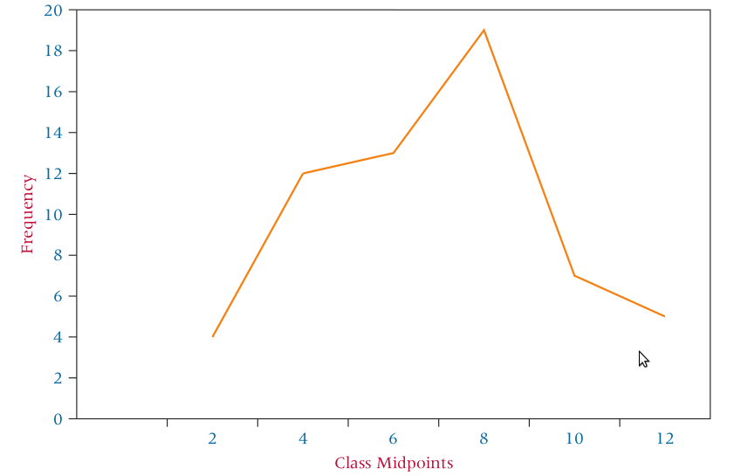
Frequency polygon

Slide 45
Ogive
Pronounced o-jive.
Is a cumulative frequency polygon.
x-axis with the class endpoints and the y-axis with the cumulative frequencies.
Ogives are most useful when the decision maker wants to see running totals.
Steep slopes in an ogive can be used to identify sharp increases in frequencies.

Slide 46
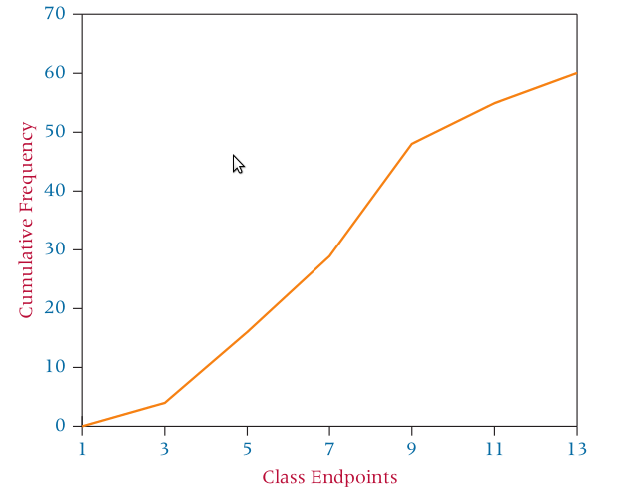
Ogive

Slide 47

Dot Plots
Relatively simple statistical chart that is generally used to display continuous, quantitative data.
In a dot plot, each data value is plotted along the horizontal axis and is represented on the chart by a dot.
If multiple data points have the same values, the dots will stack up vertically.

Slide 48
Dot plots can be especially useful for observing the overall shape of the distribution of data points
along with identifying data values or intervals for which there are groupings and gaps in the data.

Slide 49
Stem-and-Leaf Plot
Another way to arrange raw data into groups besides using frequency distribution.
constructed by separating the digits for each number of the data into two groups, a stem and a leaf.
Say we have following raw data:
86, 77, 91, 60, 55, 76, 92, 47, 88, 67, 23, 59, 72, 75, 83, 77, 68, 82, 97, 89, 81, 75, 74, 39, 67, 79, 83, 70, 78, 91, 68, 49, 56, 94, 81

Slide 50
Stem | Leaf
constructed by separating the digits for each number of the data into two groups, a stem and a leaf.
The leftmost digits are the stem and consist of the higher valued digits.
The rightmost digits are the leaves and contain the lower values.

Slide 51
Uses
whether the scores are in the upper or lower end of each bracket and also determine the spread of the scores.
the values of the original raw data are retained. (whereas most frequency distributions and graphic depictions use the class midpoint to represent the values in a class)
Notes:
(whereas most frequency distributions and graphic depictions use the class midpoint to represent the values in a class)

Slide 52
Data graphs
Quantitative data graphs
Histogram
Frequency Polygon
Qualitative data graphs
Pie charts
Ogive
Stem-leaf-plot
Bar charts
Pareto charts
Plotted along a numerical scale
Plotted along a non-numerical categories

Slide 53
Qualitative Data Graphs
Pie charts
Bar Charts
Pareto Charts

Slide 54
Pie charts
“A pie chart is a circular depiction of data where the area of the whole pie represents 100% of the data and slices of the pie represent a percentage breakdown of the sublevels.”
Shows the relative magnitude of the parts to the whole.
Used to:
Show relative data
Make comparisons
Ex.
Budget categories.
Market shares.
Time/resource allocations, etc.
Does not represent the total value but the relative data.

Slide 55
Type | Budget allocation(in Lacs)
Books | 8.2
Journals | 3.2
General | 1.4
Book Bank | 1.2

Slide 56
Method of construction
Convert the raw figures to proportions by dividing each figure by the total of all the figures.
Analogous to the relative frequency for FD.
As the angle at the center of circle total at 360˚, each proportion is then multiplied by 360˚.
The correct number of degrees to represent each item is obtained in the last step.
Use compass to layout the slices for each item.

Slide 57
Age group and library visits in a year
13-19 12,000
20-32 96,000
33-200 36,000

Slide 58
Bar graph
A bar graph or chart contains two or more categories along one axis and a series of bars, one for each category, along the other axis.
2 Dimensional as opposed to one dimensional histograms.
The length of the bar represents the magnitude of the measure for each category.
The bars can be:
Horizontal – Bar charts-(Excel).
Vertical – Column charts(Excel).
Easier interpretation than Pie Charts.

Slide 59
Type | Budget allocation(in Lacs)
Books | 8.2
Journals | 3.2
General | 1.4
Book Bank | 1.2

Slide 60
Compound bar charts

Slide 61
Pareto Charts
It is an application of bar graphs.
TQM strives to find out causes of problems in products and processes.
A graphical technique for displaying problem causes is Pareto analysis.
Pareto analysis is a quantitative tallying of the number and types of defects that occur with a product or service.

Slide 62
This tally is used to produce a vertical bar chart that displays the most common types of defects, ranked in order of occurrence from left to right.
Pareto charts were named after an Italian economist, Vilfredo Pareto.
“A Pareto chart enables quality-management decision makers to separate the most important defects from trivial defects, which helps them to set priorities for needed quality improvement work.”
Notes:
Pareto charts were named after an Italian economist, Vilfredo Pareto, who observed more than 100 years ago that most of Italy’s wealth was controlled by a few families who were the major drivers behind the Italian economy. Quality expert J. M. Juran applied this notion to the quality field by observing that poor quality can often be addressed by attacking a few major causes that result in most of the problems.

Slide 63
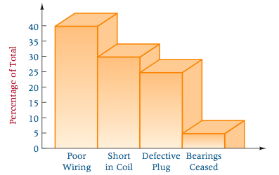
40% of the defects involved poor wiring, 30% involved a short in the coil, 25% involved a defective plug, and 5% involved cessation of bearings.
Company would probably begin to improve quality by examining the segments of the production process that involve the wiring.

Slide 64
Scatter Plot
Many times in research it becomes important to explore the relationship between two numerical variables.
2D graph plot of pairs of points from two numerical variables.

Slide 65
Size(Sq Ft) | Price (Rs.)
1400 | 98,000
2400 | 168,000
1800 | 126,000
1900 | 133,000
1300 | 91,000
1100 | 77,000

Slide 66
What we learnt?
Data
Grouped, ungrouped
FD, RF, CF, range, etc.
Graphical depictions
Quantitative data graphs
Histograms, frequency polygons, Ogive, dot plot, and stem-and-leaf-plot.
qualitative data graphs
Pie chart, bar chart, Pareto chart.
Scatter plots

Slide 67
Quizzes
What is the most important part of a statistical study?
Collecting data
Looking at data
Run statistical tools
Deciding tests to apply
If we have nominal data which graph will be best suited among these?
Pie-Chart
Bar-Chart
Histogram
Which graph is best suited for proportionate representation?
Which graph is used to find out the running totals?

Slide 68
Tabulation
Logical and systematic arrangement of statistical data in rows and columns.
Table is designed to simplify the presentation of data for the purposes of analysis and statistical inference.
Tabulation is the process of condensing classified data in the form of a table so that it may be more easily understood and so that any comparison involved may be readily made.

Slide 69
To simplify the complex data
To economise space
To facilitate comparisons( totals and subtotals)
To depict trends and pattern in data
To help reference for future studies
To facilitate statistical analysis
To detect errors and omissions
To clarify the characteristics of data

Slide 70
Table no.# : Title
Stub Heading | Caption |  |  |  |  | Total
 | Sub Head |  | Sub head
 | Column Head(1) | Column Head(2) | Column Head(3) | Column Head(4) | Column Head(5)
Total
Footnote:
Source note:

Slide 71
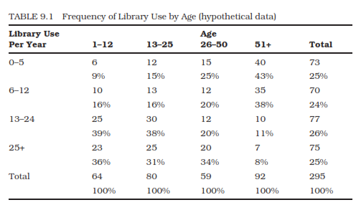

Slide 72
Rules of tabulation
No hard and fast rules.
Preapre in such a way that they can be used to the best advantage with minimum efforts.
Some general rules:
Rough draft ➔ final table
Figures to be compared should be placed close to each other
A suitable heading should be given at the top. Brief, comprehensive and self explanatory
Every table should have distinct number for easy reference
Headings of column and rows should be brief and clear
Explanatory notes should be given as footnotes.
…

Slide 73
The source from which the data is obtained should be given below the table.
The units of measurement under each heading or sub-heading must be always indicated.
0 or NA
The columns may be numbered to facilitate reference.
Total of rows should normally be placed in the extreme right column and that of columns should be placed at the bottom.
Above all, the table must suit the needs and requirements of an investigation.

Slide 74
Types of tables
On the basis of objectives or purpose
General purpose or reference table
Special purpose or summary table
On the basis of enquiry
Original or primary table
Derived or derivative table
On the basis of coverage
Simple table
Complex table

Slide 75
General and special purpose
General purpose
For ready reference and record
Data is systematically arranged without any intentions of comparative studies, relationship or significance of figures
Sole purpose is to help reader find individual items readily
Special purpose
Presents data related to a specific subject under study.
Analytical in nature
Prepared with the idea of making comparative studies and studying the relationship and the significance of figures provided by data
Interpretive figures like Ratios, percentages are used to facilitate comparisons.

Slide 76
Original or primary tables
contains initially collected data from original source
Derived or derivative tables
Presents data derived from original data, averages, standard deviations, etc

Slide 77
Simple table
Data are classified according to one characteristics only
One way table
Complex table
Two or more characteristics are used to classify data
Two way tables
Three way table
Cross tabulation

Slide 78
Example
In a trip organised by a college, there were 100 persons. The average cost works out to Rs. 150.60 per head.
There were 80 students each of whom paid Rs. 160. Members of the teaching staff were charged at a higher rate.
The number of non-teaching was 6(all males) and they were not charged. The number of females were 20% of the total of which two were lady staff members.
Tabulate the above information in proper tabular form.

Slide 79
Next
Descriptive statistics…

